Slide 1
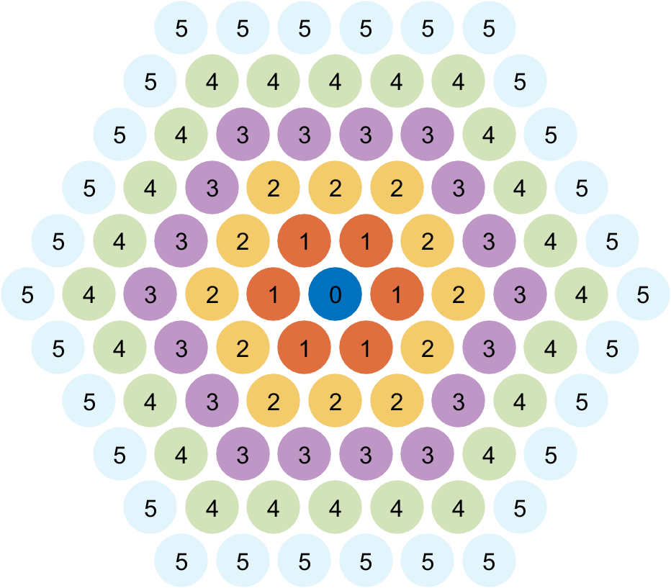
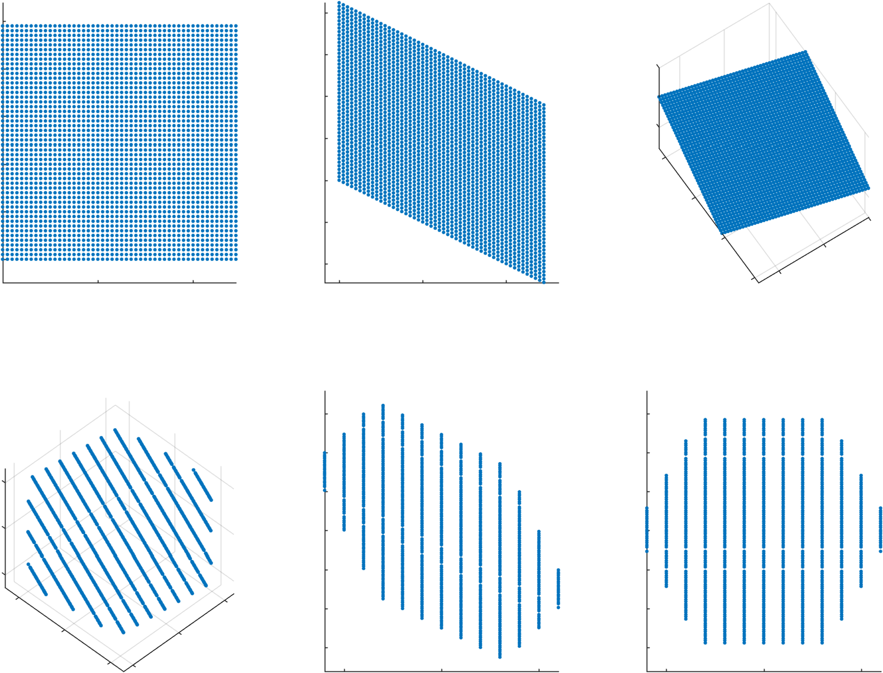
A
B
XY
Hex Coords
Cubic Coords
Wrap in Cubic Coords
Back to Hex
Back to XY

Slide 2
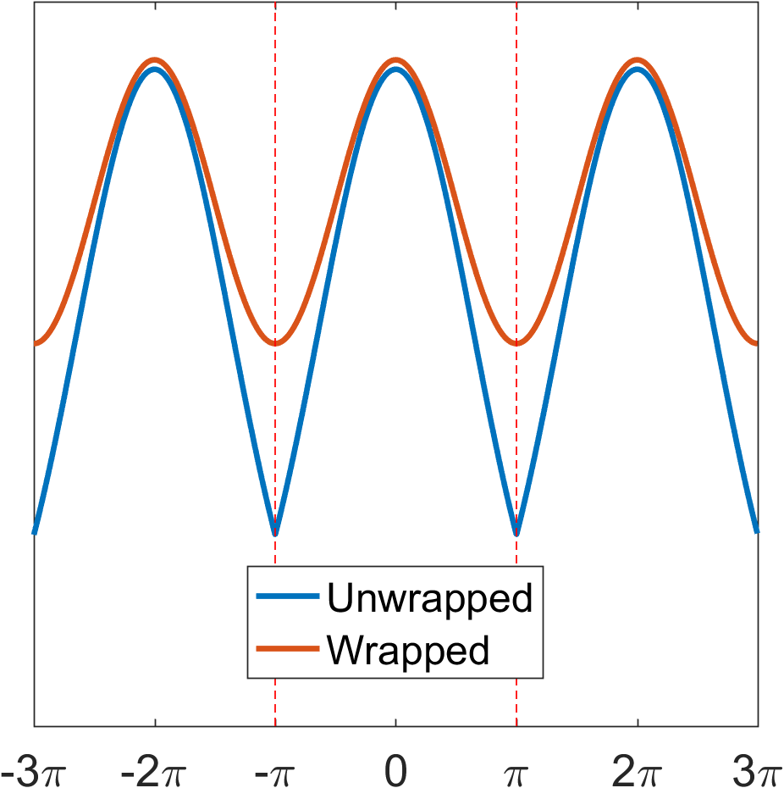
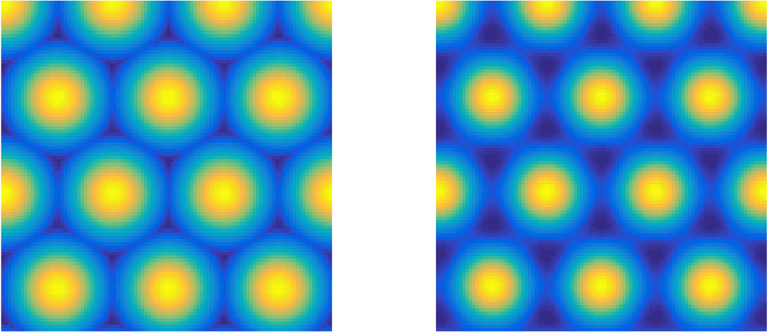
A
B
C

